Slide 1
Site Collection Planning and Architecture
Speaker Name

Slide 3
Objective
After completing this lesson, you will be able to:
Understand what aspects to consider when creating site collections
Understand what to consider when planning architecture and governance for site collections
Understand what to consider when determining the creation of a Team site or a Communication site
Guidance and key factors to consider when creating Hub sites verses subsites
Understand SharePoint Home Sites
Notes:
Introduction
This lesson introduces you to key factors to consider for site collection planning and architecture. It also provides guidance and key aspects to consider when creating Team, Communication, and Hub sites.
Objectives
After completing this lesson, you will be able to: Understand what aspects to consider when creating site collections
Understand options to consider when planning an architecture for site collections
Understand what to consider when determining the creation of a Team site or a Communication site
Guidance and key factors to consider when creating Hub sites verses subsites

Slide 4
Considerations for Site Collections
For site collections, consider the following factors:
The purpose of the site collection
The type of content that will be stored in a site collection
The amount of storage required for each site collection
Users or groups needing access
Multi-language support
Do you need a modern team site or a communication site
Does the site collection need to be Microsoft 365 group connected
Do you need subsite
Notes:
The SharePoint Online Admin Center allows you to create and manage site collections in one location. However, it is important to plan ahead to decide how you want to implement your site collections before you create them.
For more information about planning content on sites, see: https://docs.microsoft.com/en-us/sharepoint/planning-guide
Evaluate the type of sites and site collections your organization needs, by considering the answers to the following questions.
What type of content will be stored on the sites?
To evaluate this, determine the groups in your organization that use similar content types or site templates.
How much storage do you need for each site collection? When your organization purchases the SharePoint Online service, it is allocated a pool of storage based on the number of user licenses it purchased and the type of Microsoft 365 plan it purchased. To determine this, evaluate how many site collections you may need or can have. You may be able to determine this number based on the current file server usage or the type of content the site collection will host.
For information about changing the storage on site collections, see: http://office.microsoft.com/en-us/office365-sharepoint-online-enterprise-help/change-site-collection-storage-and-server-resource-quotas-HA102772729.aspx?CTT=5&origin=HA102844602
Are there divisions or groups that need to maintain separate data?
To maintain separate data, create separate site collections. For example, the permissions you grant users to access the human resource data will be different from those you allow to access the marketing collateral.
Do you need multilingual support? - The Multilingual User Interface (MUI) feature allows users to view sites or web pages in a language other than the default set on the site or site collection. The MUI feature is not a translation tool; it just changes the display language for certain default interface elements.
If you do, ensure that you choose the correct language when you create your site collection.
Do you want users to have their own My Site?
If you do, plan to implement My Sites.

Slide 5
Considerations for Site Collection Governance
Governance is the set of policies and processes that help organizations achieve their business goals
For site collection governance, consider the following factors:
Site effectiveness through shared team goals
Regulatory requirements for information being stored
The type of access control that is required for users
External user access
The permissions to control who creates child sites
Enabled features and functionality at the site collection level and at the site level
Permitted customizations
Notes:
Governance is the set of policies, roles, responsibilities, and processes that guide, direct, and control how your organization cooperates to achieve business goals. These goals are focused on:
Governance of the software and the service you provide.
Application governance and the custom solutions you provide.
Management of the content and information stored by users in those services.
As you plan your site collections, you should also create a plan to govern them. When you think about how to structure and govern your site collections, consider the answers to these questions:
Does the structure of your site collections add to your organization's effectiveness?
An effective site collection consists of groups of individuals and teams that share common goals.
Does the structure allow the information architecture to meet regulatory requirements, privacy needs, and security goals?
A secure site is open to those who need the information, but is not accessible to those who should not see it.
What type of access will users need to the content?
A permissions model that allows read access, write access, or both.
Do users from outside the company need to have access?
Provide authorization for external users on only those site collections that need it.
Who will be allowed to create and manage the sites in the site collection?
A managed plan is required to ensure that sites are well-maintained.
What features and functionality will be enabled for users?
Locations for specific actions and applications, such as sandbox solutions.
Will the content found in the search results be relevant to those sharing the site collection?
A site collection where the content is useful to those sharing the site.
How much customization will you allow?
A solution that is manageable and easy to upgrade.

Slide 6

When to create a communication sites or a team site
Communication sites:
Use a communication site to broadcast information out to a broad audience.
With a communication site, typically only a small set of members contribute content that is consumed by a much larger audience.
Team sites:
If you want to collaborate with other members of your team or with others on a specific project, a team site is the better choice.
With a team site, typically all or most members can contribute content to the site and the information is limited to only the members of the team or project and specific stakeholders.
Notes:
What does a communication site include?
When you create a communication site in SharePoint Online, you can start with a blank site or choose one of the other site designs, each of which comes with a default set of web parts. The options available are:
Topic to share information such as news, events, and other content.
Showcase to use photos or images to showcase a product, team, or event.
Blank to create your own design.
No matter which one you choose, you can add, remove, or reorder web parts as needed.
If you have permission to edit the site, there's also a link at the top of the communcation site to add a new list, document library, page, news post, or web app to the site.
Topic
When you choose the Topic design, you get a home page that includes several web parts ready for you to customize. The web parts included by default on a Communication site that uses the Topic design are:
Hero: Use the Hero web part to bring focus and visual interest to your page. You can display up to five items in the Hero web part, and you can add compelling images to draw attention to each. For more information, see Use the Hero web part on a modern page.
News: You can keep your team in the loop as well as engage them with important or interesting stories by using the News web part. For more information, see Use News Headlines and News List web parts on a modern page.
Events: Display upcoming events using the events web part. For more information, see Use the Events web part.
Highlighted content: Use the Highlighted content web part to dynamically display content from a document library, a site, a site collection, or all sites. By default, this web part shows your most recent documents. For more information, see Use the Highlighted content web part.
Showcase
The Showcase design also comes with a home page that includes several web parts ready for you to customize. Here are the web parts included by default on a Communication site that uses the Showcase design:
Hero: Use the Hero web part to bring focus and visual interest to your page. With the Showcase design, you can choose from two layouts, Tile and Layer, and add compelling images to draw attention to each item. For more information, see Use the Hero web part on a modern page.

Slide 7
Hub sites

Slide 8
What is a SharePoint hub site?
Hub sites are "connective tissue" to use when organizing families of team sites and communication sites together.
One of the key principles of modern intranets based on SharePoint is that each unit of work should get a separate site collection to optimally manage governance and growth over time.
A hub site (most commonly created from a communication site) should also be considered its own unit of work that brings together numerous other sites.
A hub sites give you:
Shared navigation, Theme, and brand
Roll-up of content and search
A home destination for the hub

Slide 9
Why use SharePoint hub sites vs. subsites
Subsites
Don’t give any room for flexibility and change
Subsite hierarchies are reflected in the URL for content, if you reorganize your business relationships, you will break those intranet relationships in your content
Subsites create challenges because many features (ie. data retention and classification policies) apply to all sites within the site collection
Permission and security administration overhead when using broken inheritance
A key benefit provided by SharePoint hub sites
They model relationships as links, rather than hierarchy or ownership, so that you can adapt to the changes in the way you work in a dynamic, changing world
Instead of using subsites, we recommend creating a separate site collection for each unit of work, and connecting them by using hub sites

Slide 10
Planning Hub sites
As a starting point in your hub planning:
Think about hub sites for key functions that your users need to get work done. For example:
HR
Finance
Communications or Public Relations
Legal
IT
These functions may be represented in different organizational departments or business units in large organizations or combined into the role of a few people in smaller organizations.

Slide 11
Planning Hub sites (cont.)
Let's take HR as an example.. HR often encompasses the following sub-functions:
Using the guiding principle of creating a site collection for each unit of work, you can think about an HR family of site collections that could include 6 functional sites for each of these functions plus an HR home that connects the related sites to provide an overall HR experience.
Benefits
Pay and compensation
Talent acquisition or recruiting
Performance management
Professional development or training
Manager portal

Slide 12
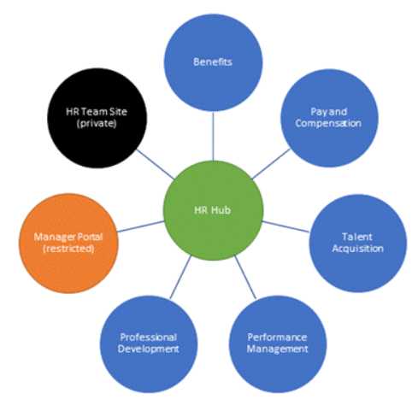
Example of HR Hub site model
This is another way to think about the value of hub sites:
They allow you to create an experience that improves information discovery for a specific context
In our example, for employees looking for HR information
Notes:
You don't have to have a hub site for every function. However, when a function provides multiple logically different services (as in the HR example), it's a good practice to create a hub site to provide a single starting place for your users. Often, intranet users start their exploration with browsing. Hub sites help combine the benefits of browsing ("I know this is an HR topic") with the benefits of a more narrowly scoped search ("I want to find information about vision benefits, not the company's strategic vision."). Even if the users don't know which sub-function provides a service, they can navigate to the HR hub and then, using the search scope provided by the hub, search (or navigate) within the HR hub to quickly find what they need.
Some organizational functions have an enterprise-wide scope but a regional or product execution. For example, think about a Sales department that may have sites for sales regions and sites for location-based offices. This type of function has always presented a challenge to hierarchical intranet content organization using subsites. Do we make the Southeast Sales site a subsite of the Southeast Region site or the Sales site? And, what happens when a state within the southeast region moves; for example, from the southeast region to the northeast region? This type of dynamic organizational movement creates a nightmare for intranet organization if you use subsites, but not with hub sites. Picking a hub may create some angst because an individual site can be associated with only one hub, but keep in mind that news, activity, and highlighted content is based on search, so it's possible to have content from one site appear on multiple hub home pages. A hub will default to only showing content from its own associated sites, but it's easy to configure it to include other related sites as well, even if those sites are associated with different hubs.

Slide 13
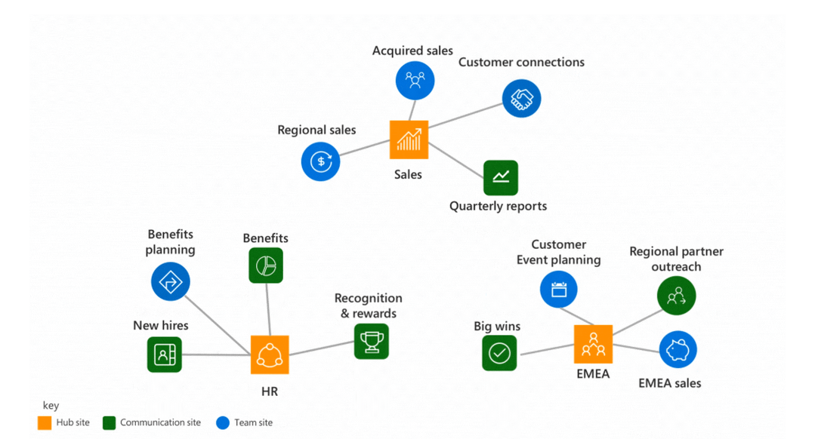
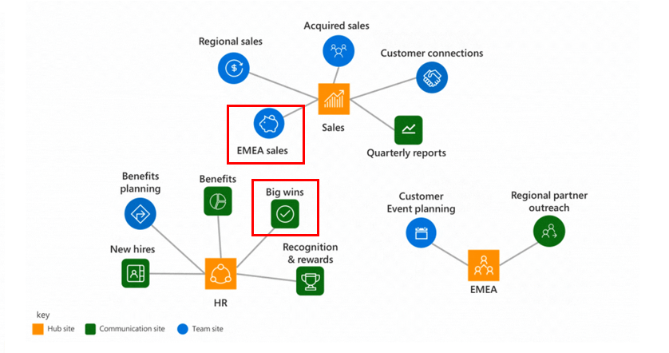
Hub site model adapts to change
As our organization evolves, you need intranets that make it easy to align to changes
A key benefit of hub sites:
They model relationships as links, rather than hierarchy or ownership
You can adapt to the changes in the way you work in a dynamic, changing world.
Notes:
What is the one thing that we can guarantee is going to happen in every business? Change! As our organization evolves, you need intranets that make it easy to align experiences with the way you work and that can adapt to the inevitable changes in the way you work. This is a key benefit provided by SharePoint hub sites; they model relationships as links, rather than hierarchy or ownership, so that you can adapt to the changes in the way you work in a dynamic, changing world.
This slide also demonstrates how a site collection can be re-associated to a different hub site.
The Big wins site collection is moved to HR hub site
The EMEA sales site collection is moved to the Sales hub site
You don't have to have a hub site for every function. However, when a function provides multiple logically different services (as in the HR example), it's a good practice to create a hub site to provide a single starting place for your users. Often, intranet users start their exploration with browsing. Hub sites help combine the benefits of browsing ("I know this is an HR topic") with the benefits of a more narrowly scoped search ("I want to find information about vision benefits, not the company's strategic vision."). Even if the users don't know which sub-function provides a service, they can navigate to the HR hub and then, using the search scope provided by the hub, search (or navigate) within the HR hub to quickly find what they need.
Some organizational functions have an enterprise-wide scope but a regional or product execution. For example, think about a Sales department that may have sites for sales regions and sites for location-based offices. This type of function has always presented a challenge to hierarchical intranet content organization using subsites. Do we make the Southeast Sales site a subsite of the Southeast Region site or the Sales site? And, what happens when a state within the southeast region moves; for example, from the southeast region to the northeast region? This type of dynamic organizational movement creates a nightmare for intranet organization if you use subsites, but not with hub sites. Picking a hub may create some angst because an individual site can be associated with only one hub, but keep in mind that news, activity, and highlighted content is based on search, so it's possible to have content from one site appear on multiple hub home pages. A hub will default to only showing content from its own associated sites, but it's easy to configure it to include other related sites as well, even if those sites are associated with different hubs.

Slide 14
Hub site administration
A site collection can be associated to only one hub
A hub cannot be associated with another hub
Site collections associated with a SharePoint hub site don't inherit the permissions of the hub site or any other sites associated with it. Each site, including the hub site, will retain their current permission settings
Content (news, events, articles) that is rolled up from associated sites to a hub site are security trimmed. Users can only see what they have permission to view
Tenants are currently limited to 2000 hub sites. You may not need a hub site for every function, so it's important to do some planning before you create hubs
You must be a SharePoint administrator to create a SharePoint hub site
Site collection administrators, however, can associate a SharePoint site with a hub site that already exists
Notes:
https://docs.microsoft.com/en-us/sharepoint/dev/features/hub-site/hub-site-overview#additional-details

Slide 15
Hub site administration (cont.)
If you set up SharePoint Multi-Geo for your organization, only sites within the same geographical location can be associated with a hub site
If the theme for the site that was converted to a hub site was never changed from the original theme assigned by SharePoint at the time it was created, any sites associated with it will not inherit the hub site theme
Classic experience SharePoint sites that are associated with a hub site will retain their original theme
Notes:
If the theme for the site that was converted to a hub site was never changed from the original theme assigned by SharePoint at the time it was created, any sites associated with it will not inherit the hub site theme.

Slide 16
Additional considerations
On SharePoint home. Pin your hub sites to the Featured links area of SharePoint home. Encourage all users to "follow" hub sites.
On the SharePoint mobile app. Hub sites can also be found on the SharePoint mobile app and are even more discoverable if users follow hub sites.
From the organization portal. If you have an existing organizational intranet or portal, you can link to your hub sites in your existing navigation.
On each hub site. Consider adding a link to your organizational portal home page on each hub site. Add the link to the organization portal ("home home") to the far right in your hub navigation to keep the primary focus of your hub site on the hub site context.
Notes:
Additional steps to get the most out of your hub site
Change the hub site name and logo
To edit the hub site name and logo, go to the site, click Settings , and then click Hub site information. The logo height should be no more than 24 pixels.
The name and logo will appear in both the hub site navigation bar and when users associate sites with the hub.
Edit the navigation bar
You can also edit the hub site navigation bar that appears on all associated sites.
Change the hub site theme
To set the hub site theme, click Settings , and then click Change the look.
All sites associated with the hub site will inherit the theme from this site. Note that it may take a while for the theme to be applied.
Notes:
If the theme for the site that was converted to a hub site was never changed from the original theme assigned by SharePoint at the time it was created, any sites associated with it will not inherit the hub site theme.
Classic experience SharePoint sites that are associated with a hub site will retain their original theme.
Add the News web part
Add the News web part to the homepage (if it's not already there) to see news from associated sites. On the web part properties, select "sites across the hub" as the source. You can choose which associated sites display news on the hub site home page and users will only see news for sites they have access to.
Add the Sites web part
Add the sites web part to the homepage to see activity on associated sites
Add the Highlighted Content web part
Optionally, add the highlighted content web part to see spotlighted content from associated sites.

Slide 17
Home sites
A dynamic, engaging & personalized employee experience for your organization

Slide 18
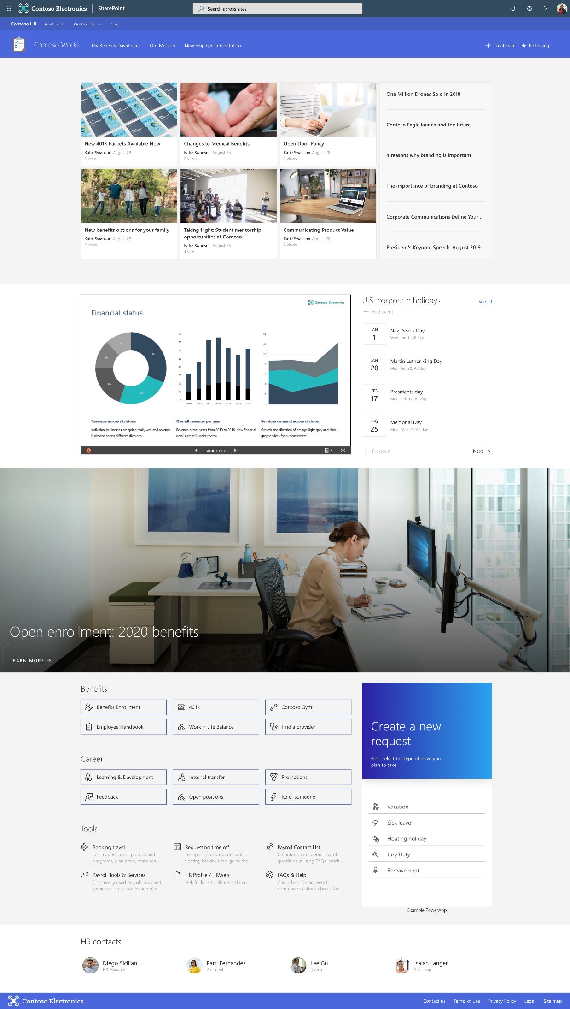
What are SharePoint home sites?
A Home site is the landing page that brings together news, content, conversations and video to deliver an engaging experience that reflects an organization’s voice, priorities and brand.
Home sites connect the digital estate with enterprise search and navigation and deliver a dynamic and highly personalized experience powered by AI, so you can connect with the information and activities that matter to you, across your devices.

Slide 19
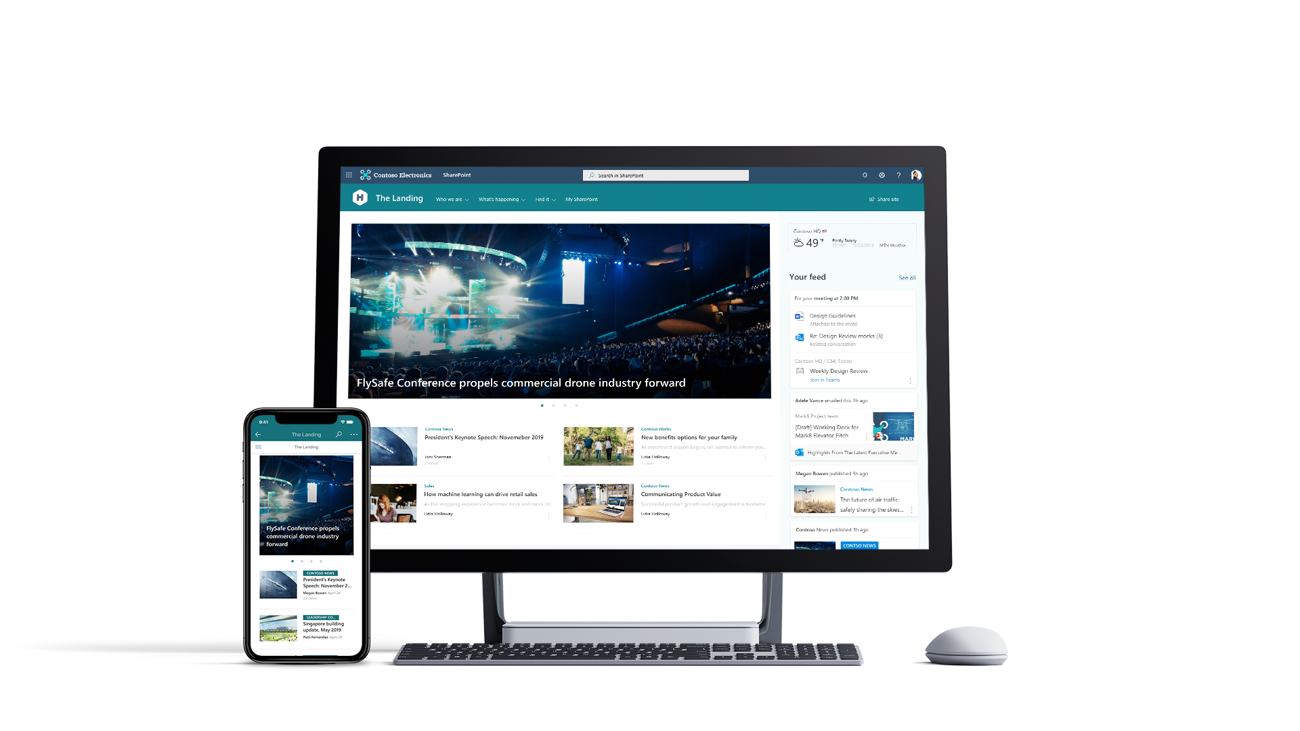
SharePoint home sites
A personalized landing page experience for your organization
Connect the workplace with intelligent search and rich navigation to sites and applications
Showcase news and information to the right people with audience targeting
Discover personalized, relevant content from Microsoft 365 and across your digital estate
Foster connections across the organization with social conversations
Share compelling communications with intelligent video
Create a beautiful, dynamic employee experience that is accessible and available across devices

Slide 20
SharePoint home sites
A SharePoint Home site
is a modern communication site in your Microsoft 365 environment
serves as the top-level landing page
brings together news, content, conversations and video to deliver an engaging experience
reflects your organization’s voice, priorities and brand.
It is NOT a new modern site template.
It is NOT a new design for communication sites
Notes:
NOTE: As of March 2020, only 1 SharePoint Home site is possible per customer Tenant.

Slide 21
Why SharePoint home sites?
SharePoint Home sites are about enabling successful intranet landing experiences for customers.
We deliver Home sites value broadly in two buckets:
Creating a landing experience – features that accrue to all modern SharePoint
Provide easy-to-use out-of-the-box features
Publishing systems to empower more
Ensuring success of the landing page experience – superpowers for a Home site
Auto configuring experiences that help with end user engagement
Integration experiences for remote users
Enabling unique engagement patterns to increase visibility of a Home site

Slide 22
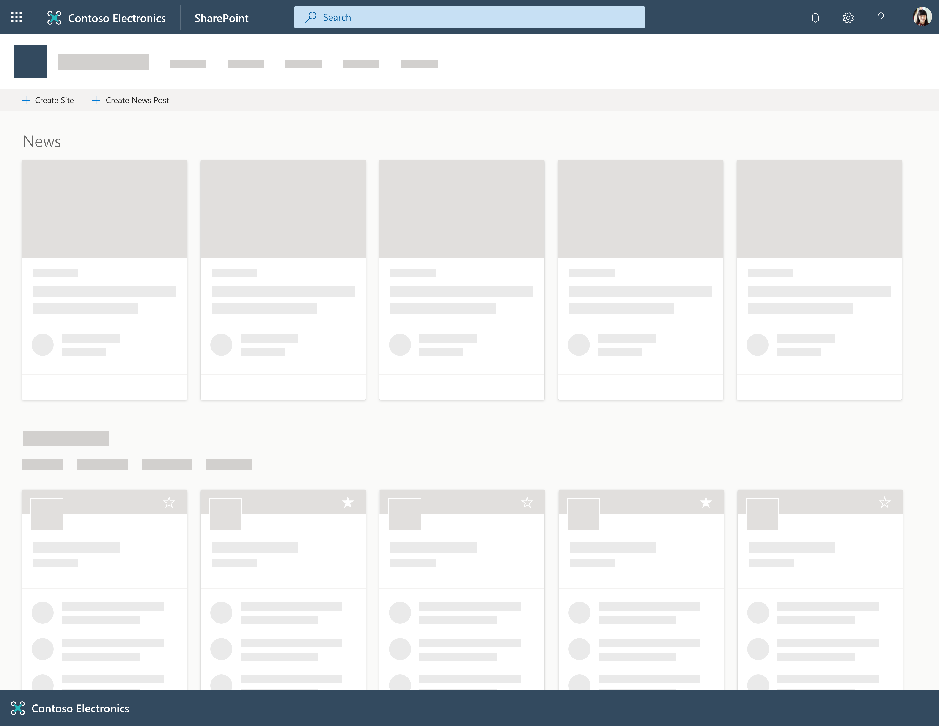
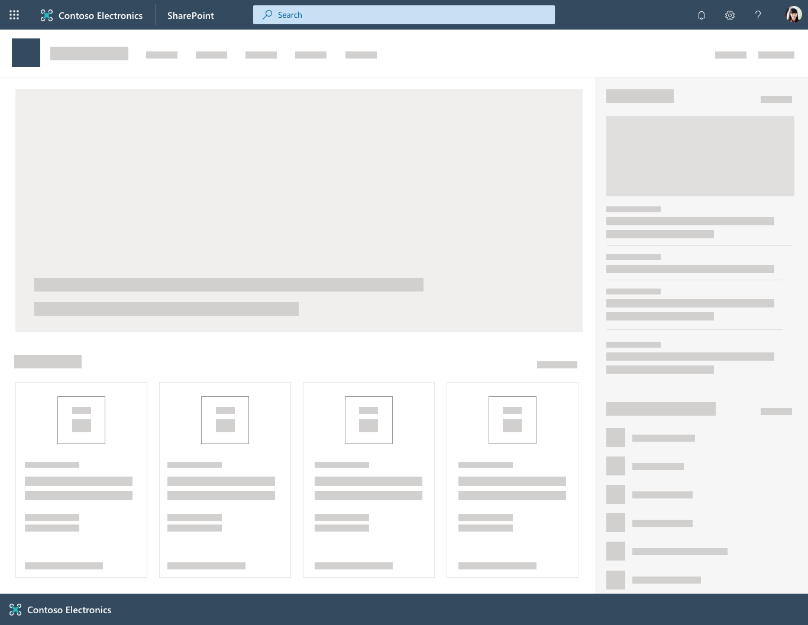
Designing your sites architecture
SharePoint start page
SharePoint home site
Marketing
Contoso Works
Sales
SharePoint hubs
Product
Finance
Benefits
Career
Ops
Big Wins
Corporate News
Leadership Connection
Accounts
Navigation/ Hyperlink
Give
Retail
Planning
Facilities
Notes:
Blue circles = Hub Sites
Grey circles = Teams Sites
Black circles = Communication sites

Slide 23
Knowledge Check
True/False: External Sharing should be considered when planning site collection governance ?
True
Which type of site collection is most commonly used for Hub site?
Communication site
By default, who can associate a site collection to a hub site?
By default, any site collection administrator can associate their site collection to a hub site. Use the Grant-SPOHubSiteRights to control permissions for hub site association
Notes:
True/False: External Sharing should be considered when planning site collection governance ?
Answer: True
Hub sites are most commonly created from which type of site collection?
Answer: Communication site
By default, who can associate a site collection to a hub site?
Answer:By default, any site collection administrator can associate their site collection to a hub site. Use the Grant-SPOHubSiteRights to control permissions for hub site association
.

Slide 24
Summary
In this lesson, you learned about:
What aspects to consider when creating site collections
What to consider when planning architecture and governance for site collections
What to consider when determining the creation of a Team site or a communication site
Guidance and key factors to consider when creating hub sites verses subsites
SharePoint Home Sites

Slide 25
Lab M4L1
Exercise 2 - Hub Site Administration

